Slide 1
Part I: 15 sec GHA
Updated 07/13/2019
Bootstrap: 1000
$$coxph\left(time, event\right)=GHA+Male+GHA ×Male$$
$$h_{0−8}(x)=h_{o}exp⁡[4.18I_{GHA}−0.70I_{Male}−{0.08I}_{GHA}×I_{Male}]$$
$$h_{8−12}(x)=h_{o}exp⁡[4.18I_{GHA}−1.59I_{Male}+{1.94I}_{GHA}×I_{Male}]$$
$$h_{12−19}(x)=h_{o}exp⁡[4.18I_{GHA}+0.43I_{Male}−0.22I_{GHA}×I_{Male}]$$
Cut off at Day 19
Notes:
Updated 07/13/2019

Slide 2
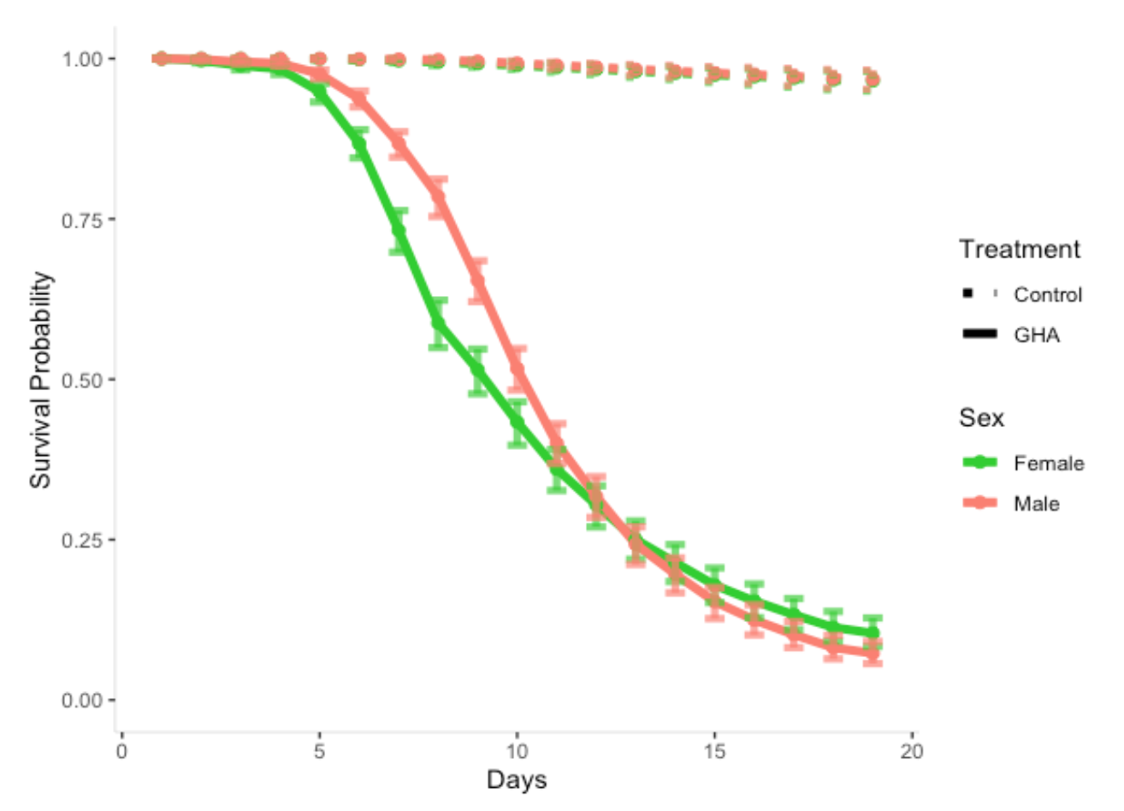
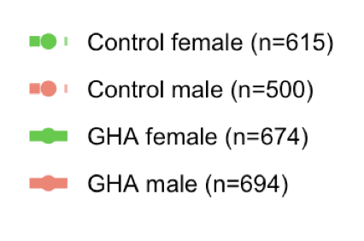
Updated 07/13/2019
Survival Probability of Control and GHA
Bootstrap: 1000
Cut off at Day 19
Notes:
Updated 07/13/2019

Slide 3
Updated 07/13/2019
*Baseline: control/fungal male
Treatment | Hazard ratios between sex | 0 - 8 | 8-12 | 12 – 19
Control | Male vs Female (p-value) | 2.02 (0.3777) | 4.90 (0.1663) | 0.65 (0.2710)
Fungal | Male vs Female (p-value) | 2.20 (0.0001) | 0.69 (0.0045) | 0.81 (0.1067)
Notes:
Updated 07/13/2019

Slide 4
Part III: SSMI by Sex
Bootstrap: 1000
$$coxph\left(time, event\right)=Fungal+Mated+Cohabit+Male+Fungal × Male+Mated × Male+Fungal × Mated$$
$$h_{0−5}(x)=h_{o}exp⁡[1.04I_{Fungal}+0.24I_{Mated}+1.03I_{Cohabit}+0.75I_{Male}−0.46I_{Fungal Male} −0.59I_{Mated Male}+0.76I_{Fungal Mated}]$$
$$h_{5−11}(x)=h_{o}exp⁡[3.94I_{Fungal}+0.22I_{Mated}+1.52I_{Cohabit}+0.75I_{Male}−0.46I_{Fungal Male} −0.59I_{Mated Male}+0.76I_{Fungal Mated}]$$
$$h_{11−21}(x)=h_{o}exp⁡[3.66I_{Fungal}−0.07I_{Mated}+0.83I_{Cohabit}+0.75I_{Male}−0.46I_{Fungal Male} −0.59I_{Mated Male}+0.76I_{Fungal Mated}]$$

Slide 5
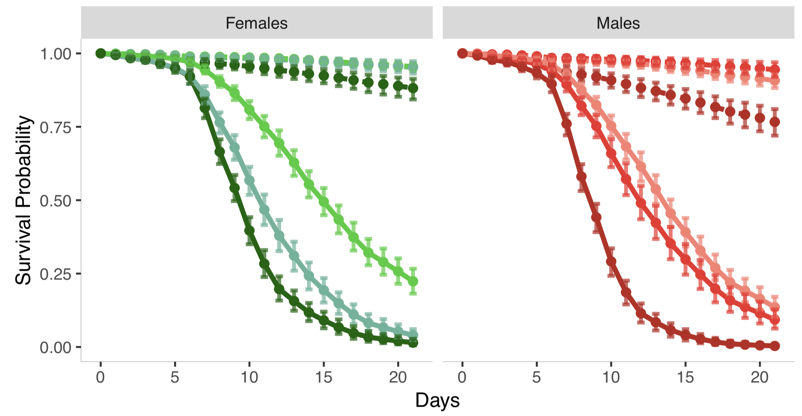
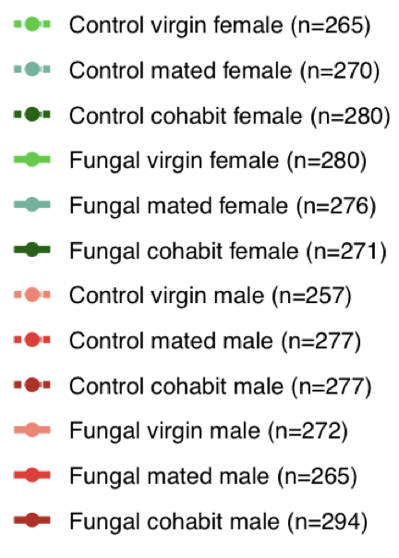
Notes:
Female _ Male

Slide 6
Treatment | Sex | Hazard ratios between mating status | 0 – 5 | 5 – 11 | 11 – 21
Control | Female | Mated vs Virgins (p-value) | 1.28 (0.4978) | 1.24 (0.4446) | 0.93 (0.8012)
Control | Female | Cohabit vs Virgins (p-value) | 2.79 (0.0014) | 4.59 (<0.0001) | 2.29 (<0.0001)
Control | Female | Cohabit vs Mated (p-value) | 2.19 (0.0219) | 3.69 (0.0003) | 2.46 (0.0046)
Control | Male | Mated vs Virgins (p-value) | 0.70 (0.3297) | 0.69 (0.1956) | 0.52 (0.0238)
Control | Male | Cohabit vs Virgins (p-value) | 2.79 (0.0014) | 4.59 (<0.0001) | 2.29 (<0.0001)
Control | Male | Cohabit vs Mated (p-value) | 3.96 (0.0005) | 6.69 (<0.0001) | 4.45 (<0.0001)
Fungal | Female | Mated vs Virgins (p-value) | 2.72 (0.0041) | 2.65 (<0.0001) | 1.99 (<0.0001)
Fungal | Female | Cohabit vs Virgins (p-value) | 2.79 (0.0014) | 4.59 (<0.0001) | 2.29 (<0.0001)
Fungal | Female | Cohabit vs Mated (p-value) | 1.03 (0.9073) | 1.73 (0.0001) | 1.15 (0.3419)
Fungal | Male | Mated vs Virgins (p-value) | 1.50 (0.1854) | 1.46 (0.0098) | 1.10 (0.4450)
Fungal | Male | Cohabit vs Virgins (p-value) | 2.79 (0.0014) | 4.59 (<0.0001) | 2.29 (<0.0001)
Fungal | Male | Cohabit vs Mated (p-value) | 1.86 (0.0178) | 3.14 (<0.0001) | 2.09 (0.0002)

Slide 7
Part IV: SSMI by Mating_status
Bootstrap: 1000
$$coxph\left(time, event\right)=Fungal+Mated+Cohabit+Male+Fungal × Male+Mated × Male+Fungal × Mated$$
$$h_{0−5}(x)=h_{o}exp⁡[1.04I_{Fungal}+0.24I_{Mated}+1.03I_{Cohabit}+0.75I_{Male}−0.46I_{Fungal Male} −0.59I_{Mated Male}+0.76I_{Fungal Mated}]$$
$$h_{5−11}(x)=h_{o}exp⁡[3.94I_{Fungal}+0.22I_{Mated}+1.52I_{Cohabit}+0.75I_{Male}−0.46I_{Fungal Male} −0.59I_{Mated Male}+0.76I_{Fungal Mated}]$$
$$h_{11−21}(x)=h_{o}exp⁡[3.66I_{Fungal}−0.07I_{Mated}+0.83I_{Cohabit}+0.75I_{Male}−0.46I_{Fungal Male} −0.59I_{Mated Male}+0.76I_{Fungal Mated}]$$

Slide 8
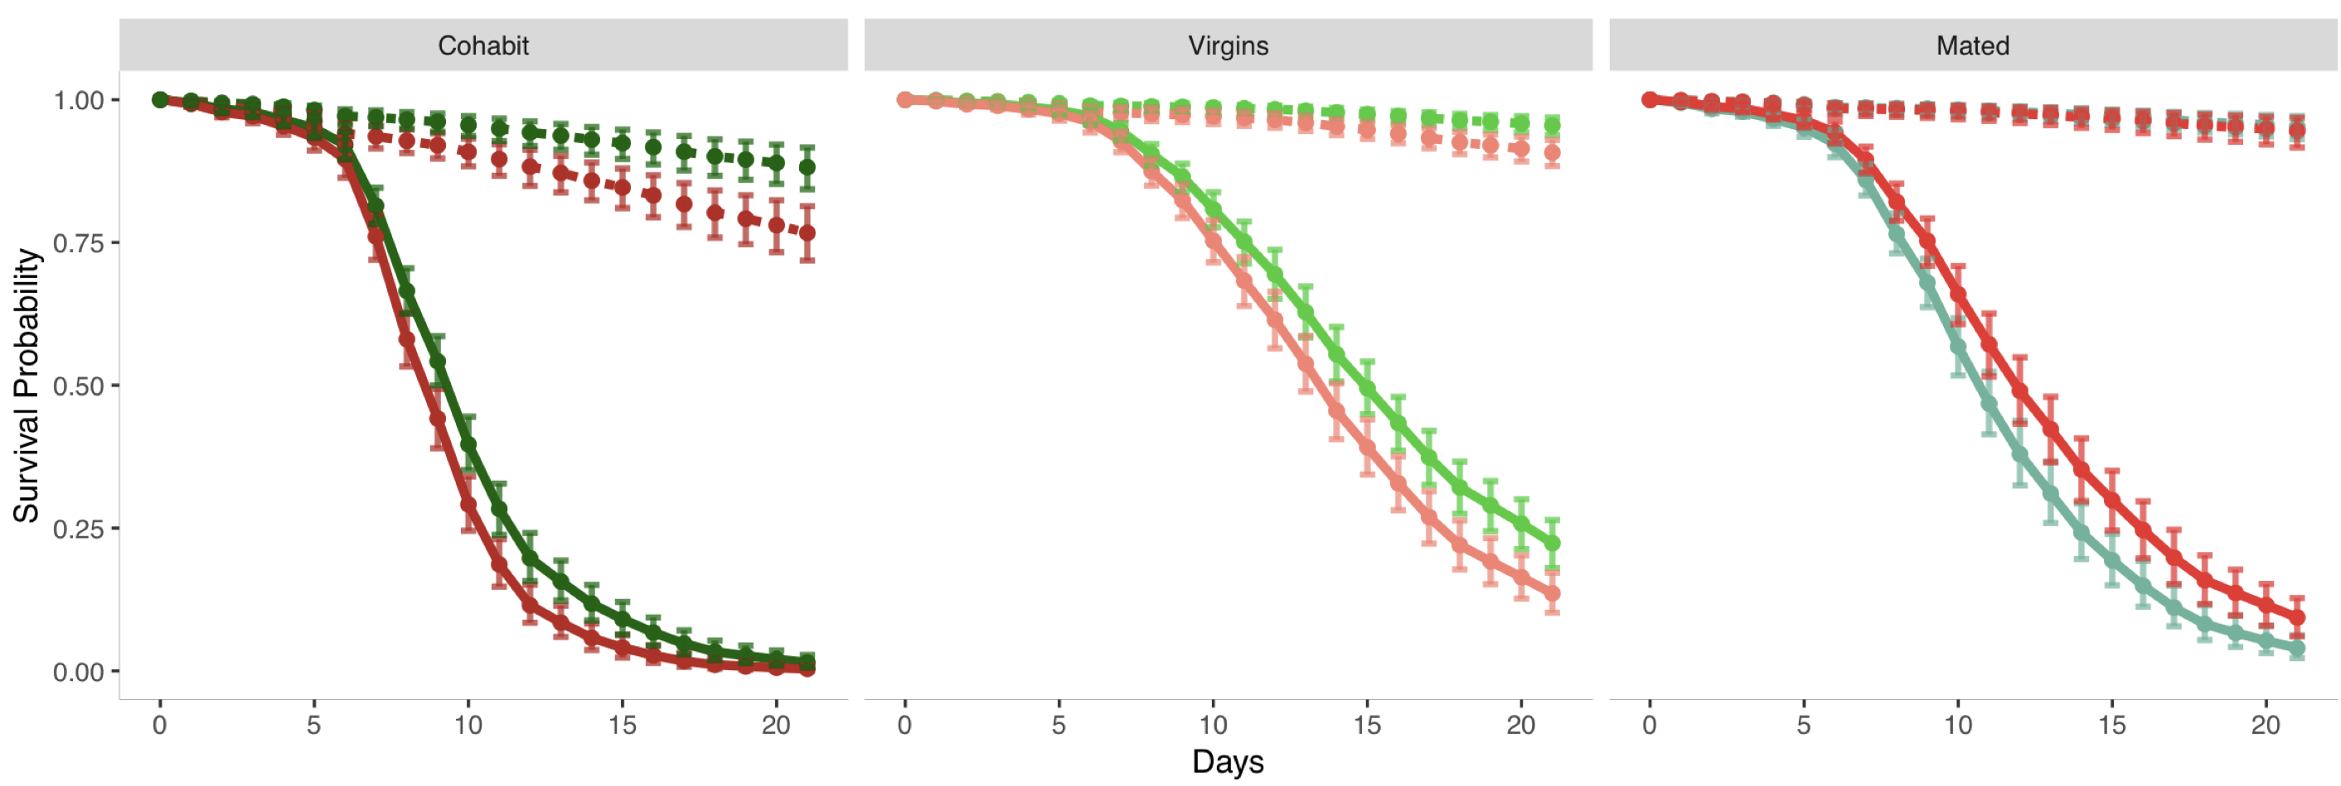
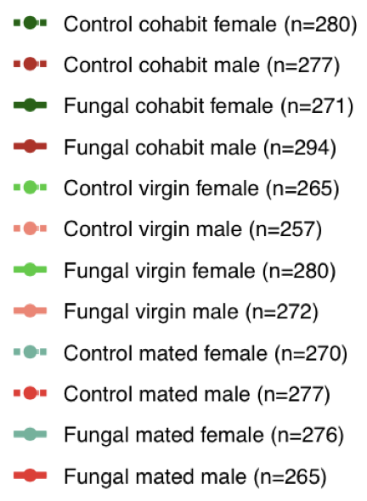
Notes:
Cohabit _ Virgin _ Mated

Slide 9
Treatment | Mating status | Hazard ratios between sex | 0 – 21
Control | Virgins | Male vs Female (p-value) | 2.11 (0.0016)
Control | Mated | Male vs Female (p-value) | 1.16 (0.4805)
Control | Cohabit | Male vs Female (p-value) | 1.33 (0.0013)
Fungal | Virgins | Male vs Female (p-value) | 2.11 (0.0016)
Fungal | Mated | Male vs Female (p-value) | 0.74 (0.0084)
Fungal | Cohabit | Male vs Female (p-value) | 1.33 (0.0013)

Slide 10
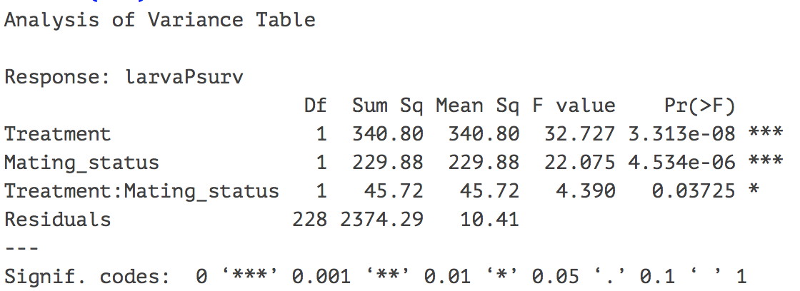
Part V: Offspring Count w/o Day
ANOVA without effect of age | p-value
Treatment | < 0.0001
Mating status | < 0.0001
Treatment:Mating status | 0.03725

Slide 11
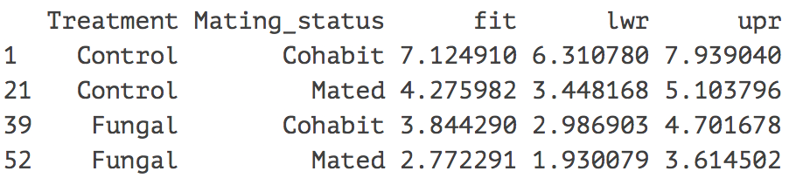
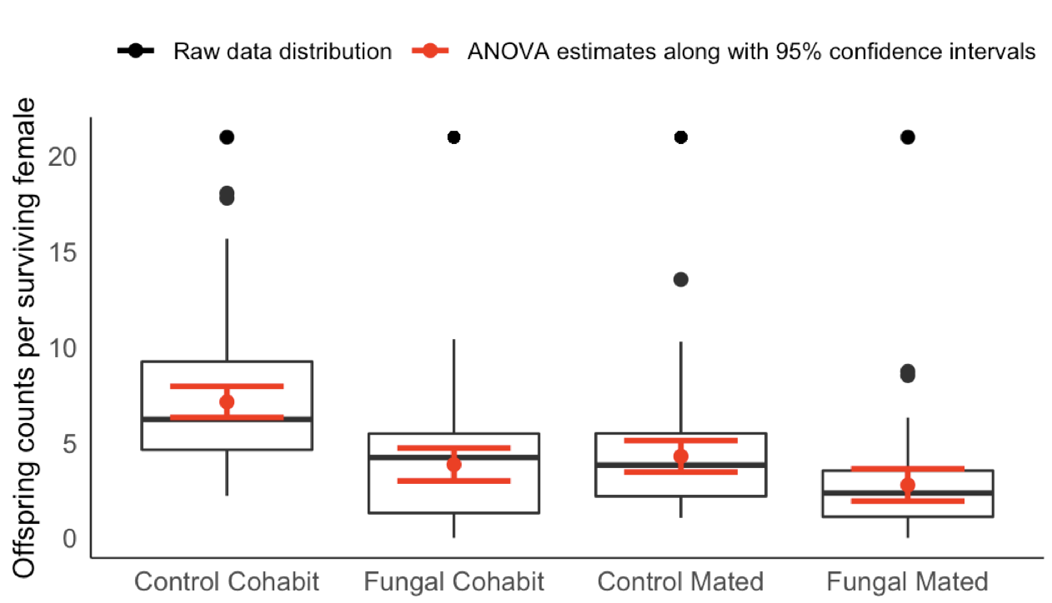
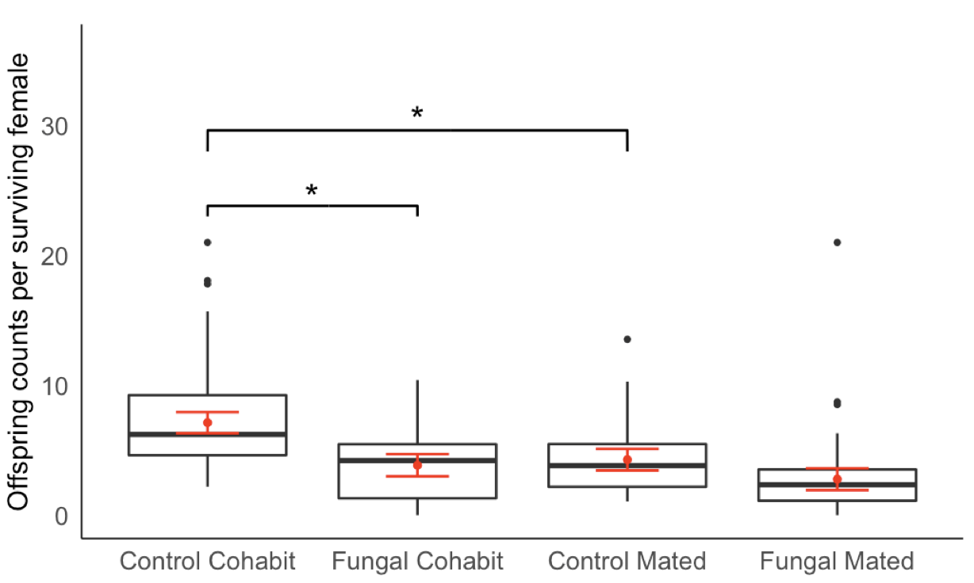
Groups | P-value
control cohabit vs fungal cohabit | 0.01203 *
control mated vs fungal mated | 0.08702
control cohabit vs control mated | 0.01687 *
fungal cohabit vs fungal mated | 0.17707
Signif. codes: 0.01 ‘*’ 0.05

Slide 12
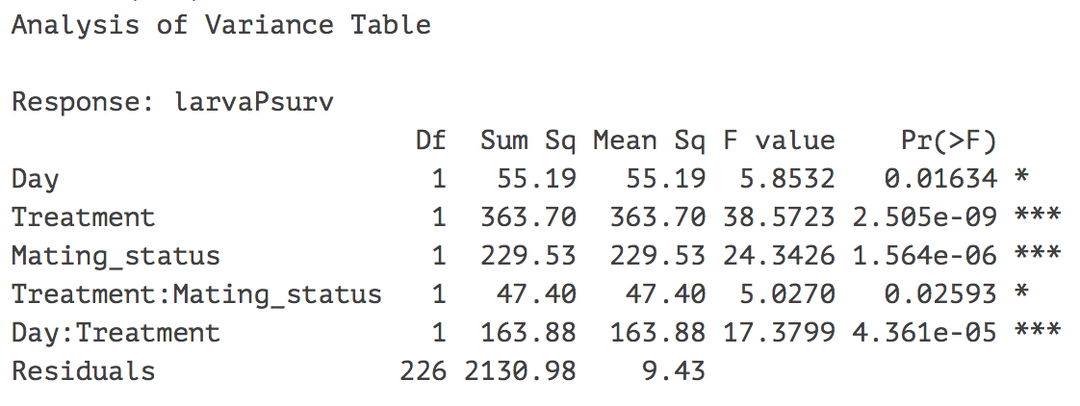
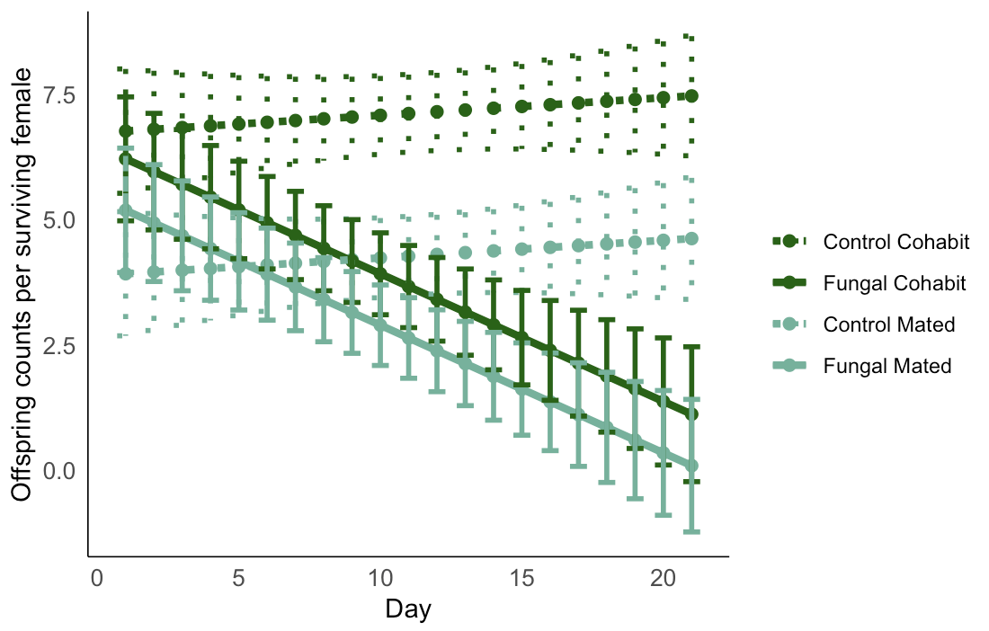
Part VI: Offspring Count with Day
ANOVA with effect of age | p-value
Day | 0.01634
Treatment | < 0.0001
Mating status | < 0.0001
Treatment:Mating status | 0.02593
Day:Treatment | < 0.0001

Slide 13
Part V: Diet

Slide 14
$$coxph\left(time, event\right)=Fungal+Male+Diet+Fungal×Diet+Fungal×Male+ Male×Diet_{C+Y,C+Y}$$
$$+Fungal×Male×Diet_{C+Y,C+Y}+Fungal×Male×Diet_{G,G}$$
$$h_{0−4}(x)=$$
$$h_{o}exp⁡[0.35I_{Fungal}+0.03I_{Male}−0.45I_{C,C}+0.31I_{C+Y,C}−0.11I_{C+Y,C+Y}+0.41I_{G,G}+ 3.02I_{Fungal }×I_{C,C}+0.89I_{Fungal }×I_{C+Y,C}+0.40I_{Fungal }×I_{C+Y,C+Y}+1.15I_{Fungal }×I_{G,G}+ 0.81I_{Fungal }×I_{Male}+3.03I_{Male }×I_{C+Y,C+Y} +{ 1.02I}_{Fungal }×I_{Male}×I_{C+Y,C+Y}+{0.24I}_{Fungal }×I_{Male}×I_{G,G}]$$
$$h_{4−9}\left(x\right)=$$
$$h_{o}exp⁡[2.96I_{Fungal}−0.36I_{Male}+0.23I_{C,C}+0.73I_{C+Y,C}+0.38I_{C+Y,C+Y}+0.14I_{G,G}+ 3.02I_{Fungal }×I_{C,C}+0.89I_{Fungal }×I_{C+Y,C}+0.40I_{Fungal }×I_{C+Y,C+Y}+1.15I_{Fungal }×I_{G,G}+ 0.81I_{Fungal }×I_{Male}+2.84I_{Male }×I_{C+Y,C+Y}+{ 0.48I}_{Fungal }×I_{Male}×I_{C+Y,C+Y}+0.24I_{Fungal }×I_{Male}×I_{G,G}]$$
$$h_{9−14}\left(x\right)=$$
$$h_{o}exp⁡[3.76I_{Fungal}+0.32I_{Male}−0.04I_{C,C}+0.63I_{C+Y,C}+0.66I_{C+Y,C+Y}−0.80I_{G,G}+ 3.02I_{Fungal }×I_{C,C}+0.89I_{Fungal }×I_{C+Y,C}+0.40I_{Fungal }×I_{C+Y,C+Y}+1.15I_{Fungal }×I_{G,G}+ 0.81I_{Fungal }×I_{Male}+0.83I_{Male }×I_{C+Y,C+Y}+{ 1.16I}_{Fungal }×I_{Male}×I_{C+Y,C+Y}+0.24I_{Fungal }×I_{Male}×I_{G,G}]$$

Slide 15
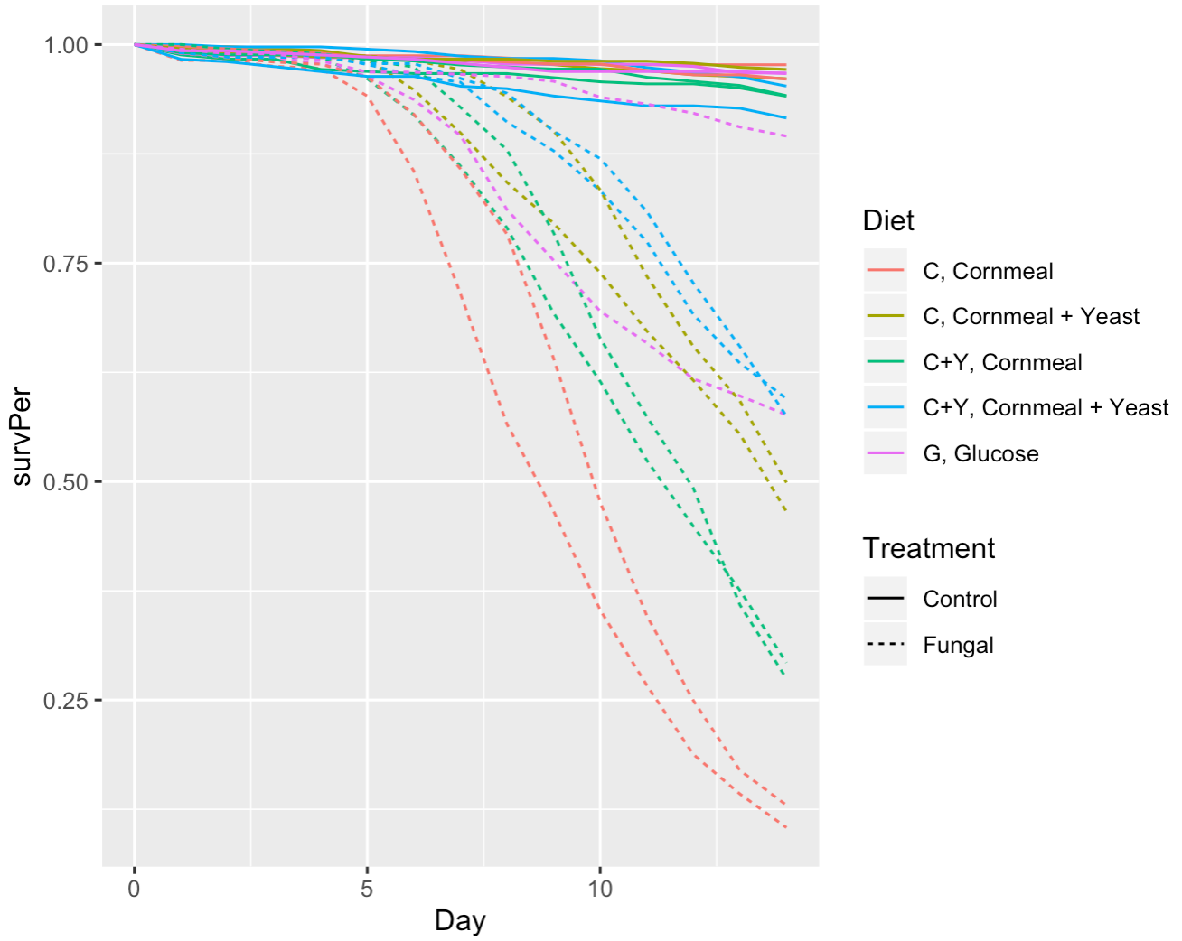
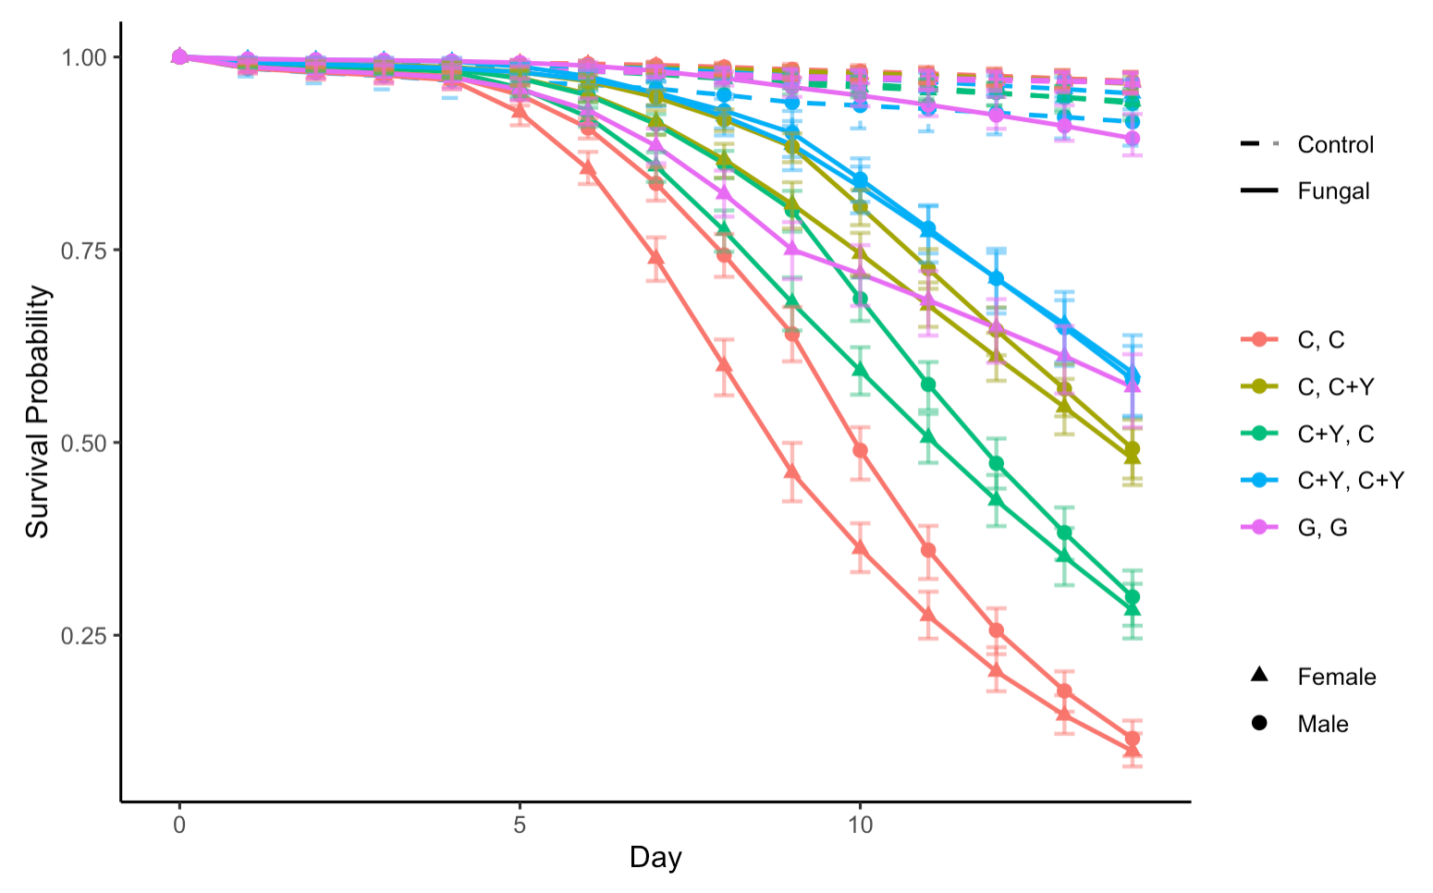
Figure 1: overall survival plot
Bootstrap: 200
Raw data plot
Model plot

Slide 16
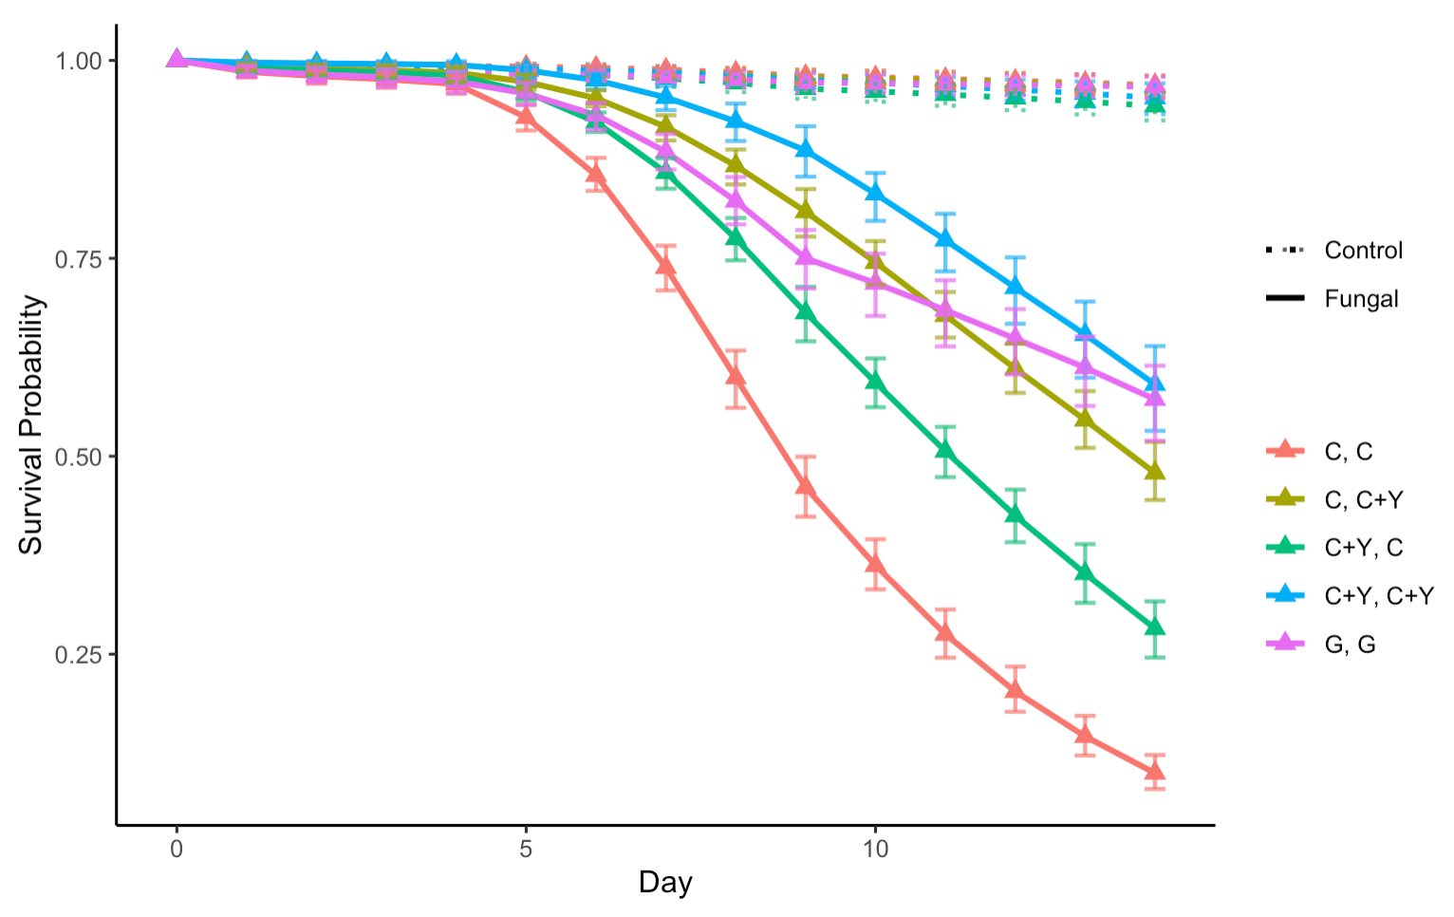
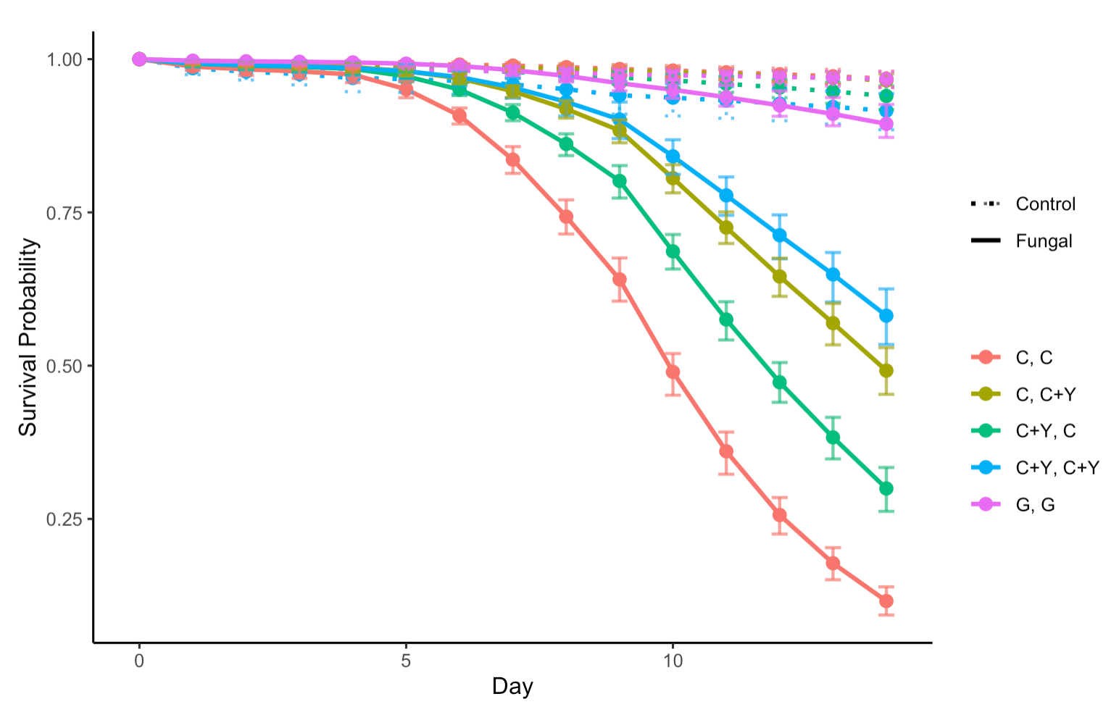
Figure 2: survival plots by Sex
Bootstrap: 200
Female
Male

Slide 17
Table 2: hazard ratios by Sex
Female
Male
Baseline: C, C + Y |  | 0 – 4 | 4 - 9 | 9 - 14
Hazard ratio (P-value) | C + Y, C + Y | 0.36 (0.0564) | 0.59 (0.0052) | 0.77 (0.0311)
 | C + Y, C | 1.22 (0.5342) | 1.86 (9.2327e-06) | 1.68 (2.3177e-07)
 | G, G | 1.732002 (0.1089984) | 1.326148 (0.04807224) | 0.52 (1.4070e-05)
 | C, C | 1.93 (0.0404) | 3.79 (2.1450e-13) | 2.92 (2.1760e-14)
Baseline: C, C + Y |  | 0 – 4 | 4 - 9 | 9 - 14
Hazard ratio (P-value) | C + Y, C + Y | 1.11 (0.8282) | 0.80 (0.2828) | 0.75 (0.0118)
 | C + Y, C | 1.22 (0.5342) | 1.86 (9.2327e-06) | 1.68 (2.3177e-07)
 | G, G | 0.41 (0.0196) | 0.31 (4.3652e-06) | 0.12 (7.6783e-13)
 | C, C | 1.93 (0.0404) | 3.79 (2.1450e-13) | 2.92 (2.1760e-14)

Slide 18
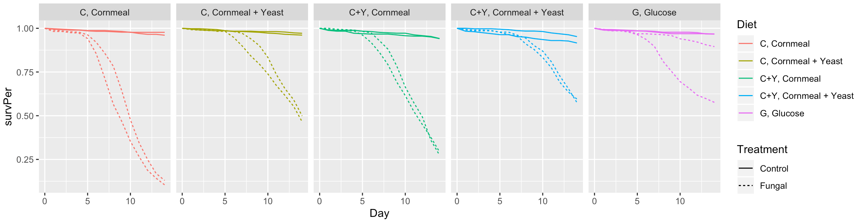
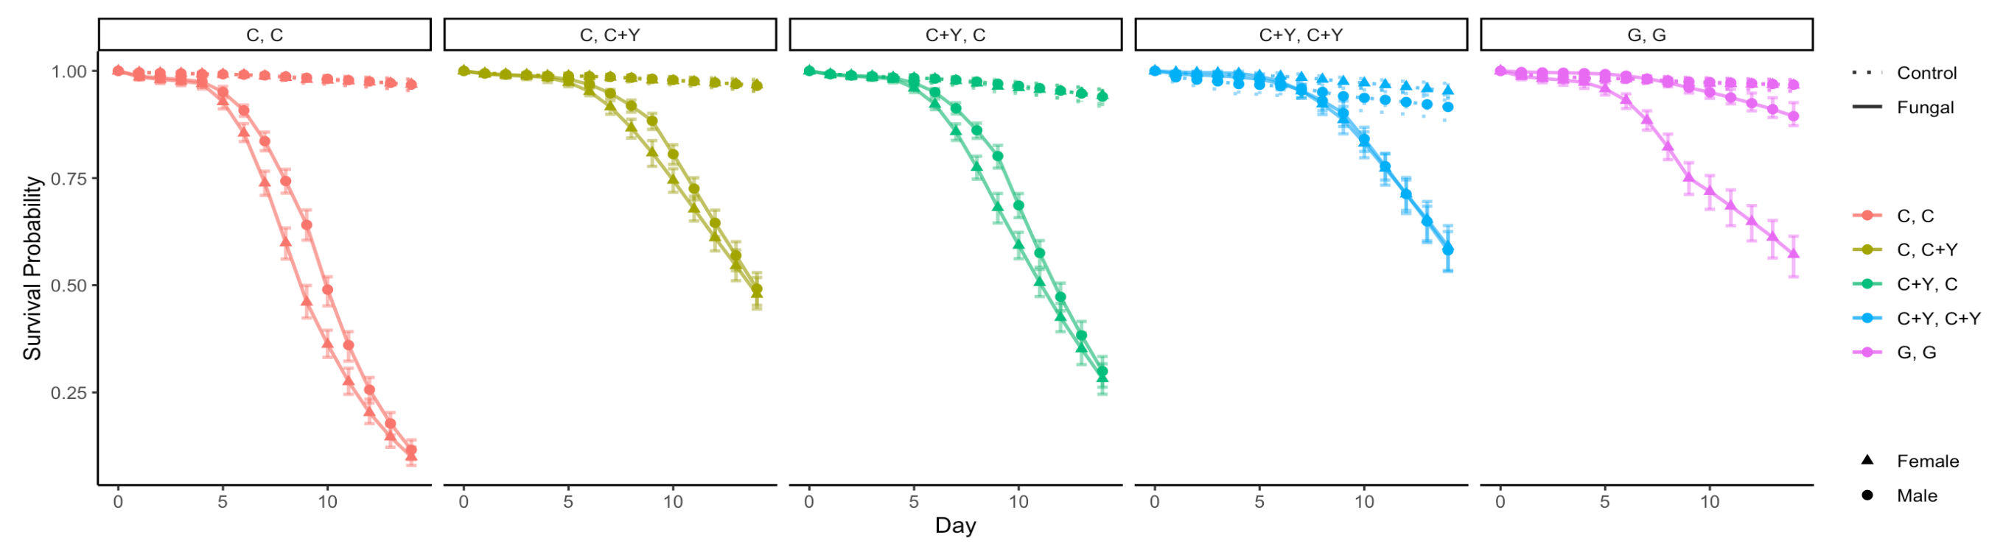
Figure 3: survival plots by Diet
Raw data plot
Model plot
Bootstrap: 200

Slide 19
Table 3: hazard ratios by Diet
Baseline: Male | 0-4 | 4-9 | 9-14
Control (p-value) | 0.97 (0.8863) | 1.44 (0.0783) | 0.72 (0.1079)
Fungal (p-value) | 1.20 (0.4208) | 1.77 (2.6149e-08) | 0.90 (0.0826)
Diet 1: C, C
Diet 2: C, C + Y
Diet 3: C + Y, C
Baseline: Male | 0-4 | 4-9 | 9-14
Control (p-value) | 0.32 (0.0368) | 0.51 (0.1274) | 0.87 (0.7435)
Fungal (p-value) | 0.39 (0.1325) | 1.29 (0.2599) | 0.93 (0.5406)
Diet 4: C + Y, C + Y
Diet 5: G, G
Baseline: Male | 0-4 | 4-9 | 9-14
Control (p-value) | 0.97 (0.8863) | 1.44 (0.0783) | 0.72 (0.1079)
Fungal (p-value) | 5.07 (1.6869e-06) | 7.52 (8.5190e-12) | 3.79 (3.6622e-08)

